Slide 1
INFERENCE MAPPING
Sri Venkateshwara college of engineering and Technology-Task-10-Inference mapping

Slide 2
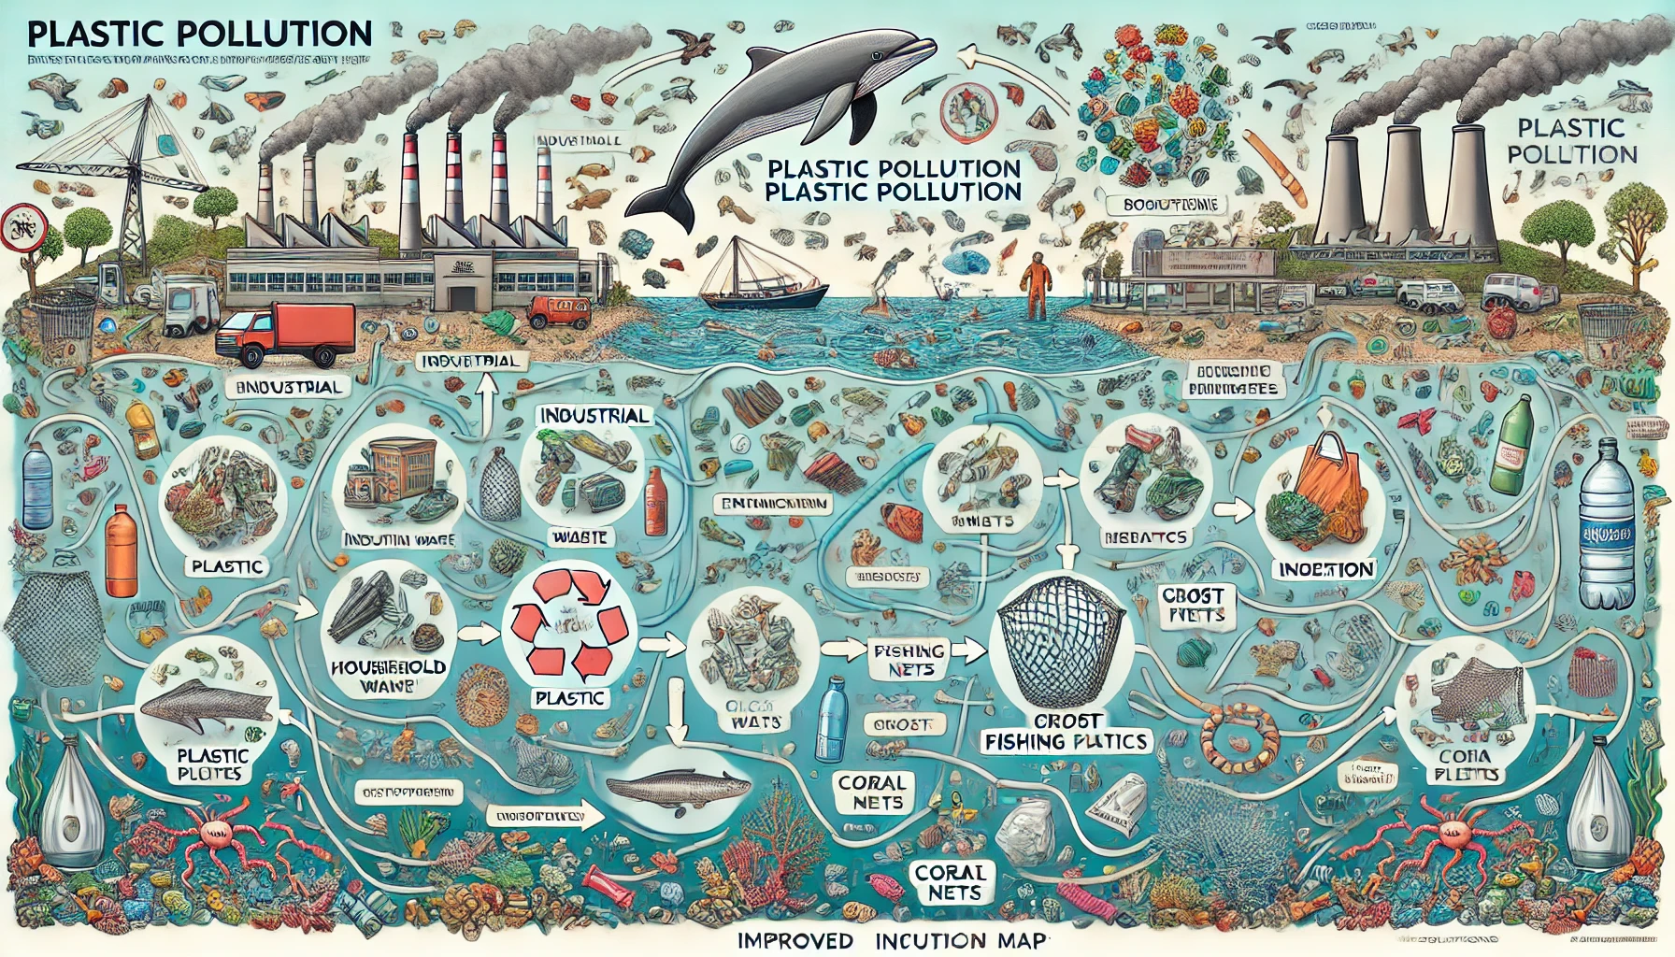
Inference Mapping for Plastic Pollution & Marine Life
An Inference Map that visually connects the problem, causes, effects, and solutions related to plastic pollution in marine ecosystems.
1. Problem Statement
Plastic pollution in oceans is harming marine life, ecosystems, and biodiversity.
⬇️
2. Causes of Plastic Pollution
🔹 Waste Mismanagement – Improper disposal of plastics leads to ocean contamination. 🔹 Microplastic Discharge – Wastewater treatment plants release billions of plastic particles daily. 🔹 Fishing Gear Abandonment – Lost nets ("ghost nets") entangle marine species.
3. Effects on Marine Life
⚠️ Entanglement – Marine animals like turtles and whales get caught in plastic waste, leading to injuries or death. ⚠️ Ingestion – Fish, birds, and mammals consume plastics, causing malnutrition and poisoning. ⚠️ Ecosystem Disruption – Coral reefs and seafloor habitats suffer damage from accumulating plastic debris.
⬇️

Slide 3
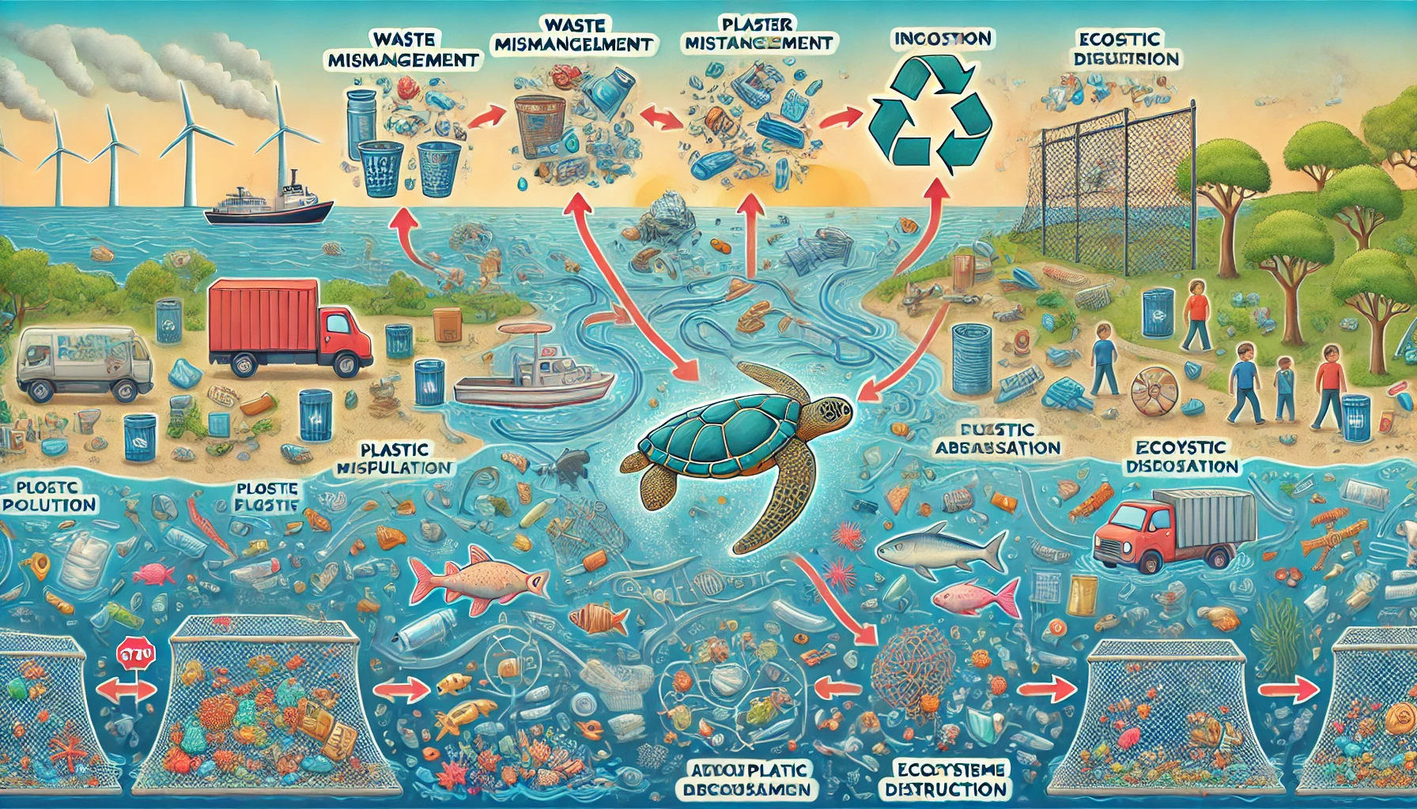
4. Solutions & Mitigation Strategies
✅ Waste Management Improvement – Enhance recycling and waste disposal systems. ✅ Upgrading Water Treatment – Use advanced filtration to reduce microplastic discharge. ✅ Legislation & Policy – Ban single-use plastics and regulate industrial waste. ✅ Public Awareness – Educate people on reducing plastic usage and promoting sustainable alternatives.
⬇️
5. Conclusion
By implementing better waste management, stricter regulations, and public awareness campaigns, we can significantly reduce plastic pollution and protect marine life. 🌍🐬

